Slide 1
Curve
Presented By:
Dr. Sk. Md. Masudul Ahsan
Professor
CSE, KUET
Md Nazirul Hasan Shawon
Lecturer
CSE, KUET

Slide 2
Outlines
What You Will See Today
What We Are Going To Do
Screen Coordinate to World Coordinate System
Viewport
Viewport Transformation
Bezier Curve
3D Object Drawing
References

Slide 3
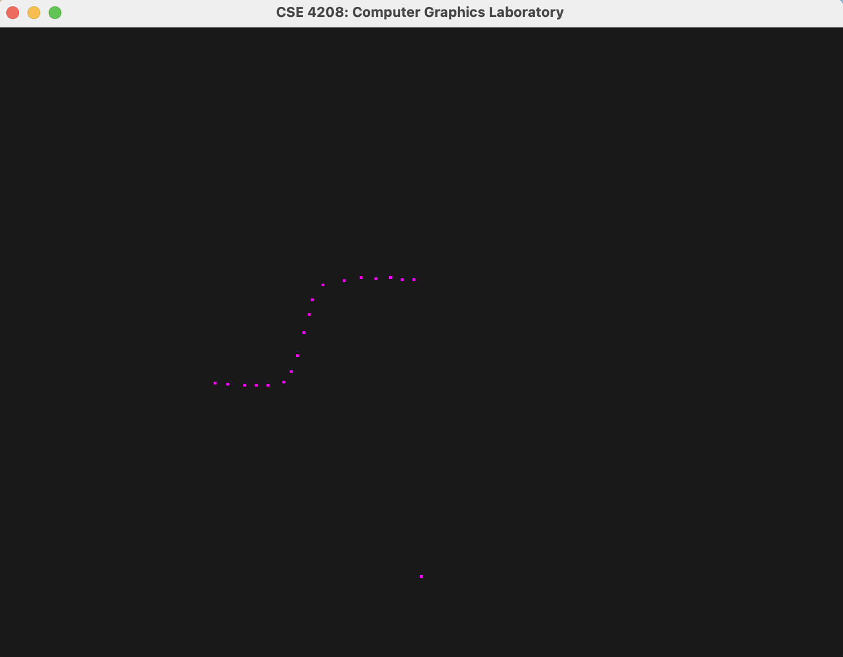
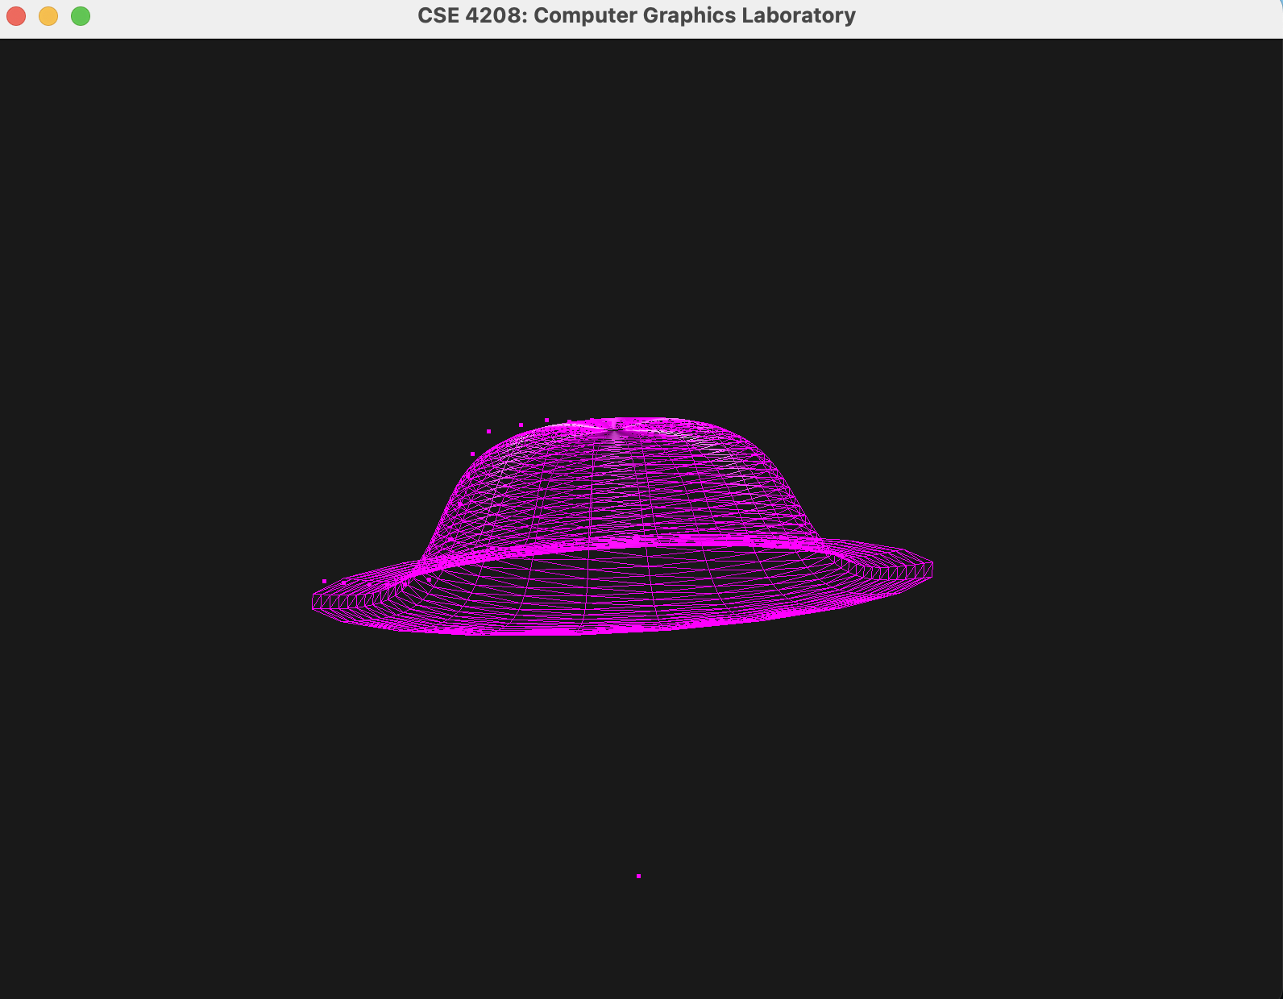
What You Will See Today

Slide 4
What We Are Going To Do
At first, We will click on the output screen using the mouse and obtain the screen coordinates of those points.
After that, we will convert those points from screen coordinates to world coordinates.
These points will be treated as the control points of the bezier curve.
Using these control points and the Bezier curve equation, we will obtain points on the curve by varying parameter t from 0 to 1.
Finally, coordinates for a 3D object will be calculated by rotating the points on the curve around the Y-axis by a specified angle. (Concept of swept surface)

Slide 5
Screen Coordinate to World Coordinate System
Screen Coordinates
World Coordinates
Viewport
Projection
View
Model
-1
World Coordinates
Screen Coordinates
Viewport
Projection
View
Model

Slide 6
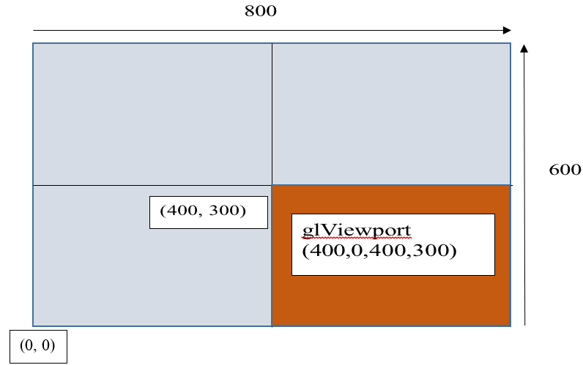
Viewport

Slide 7
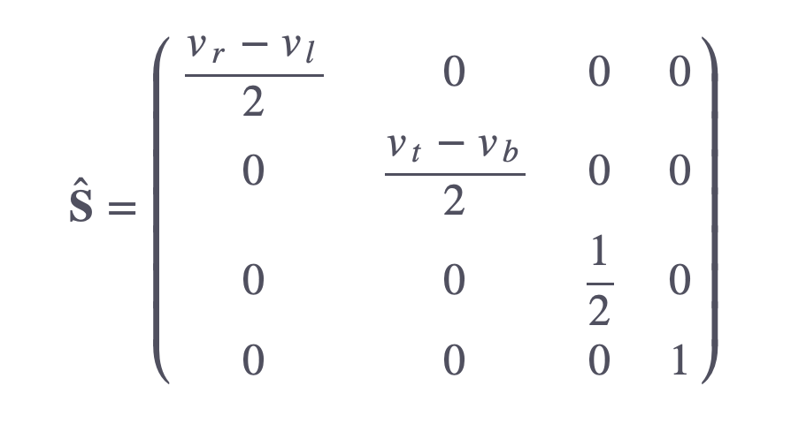
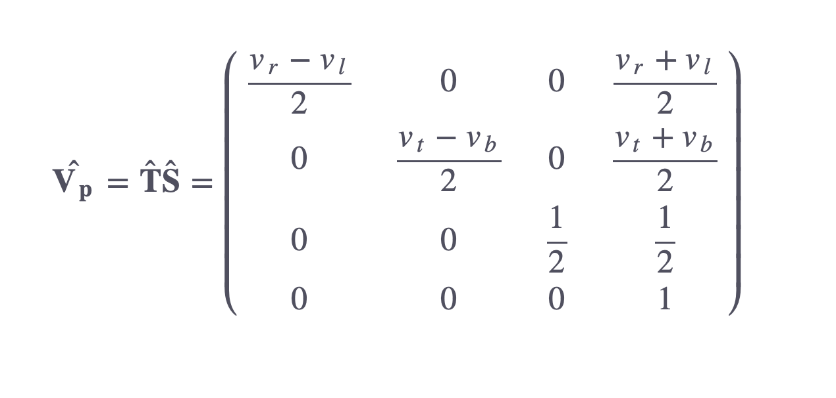
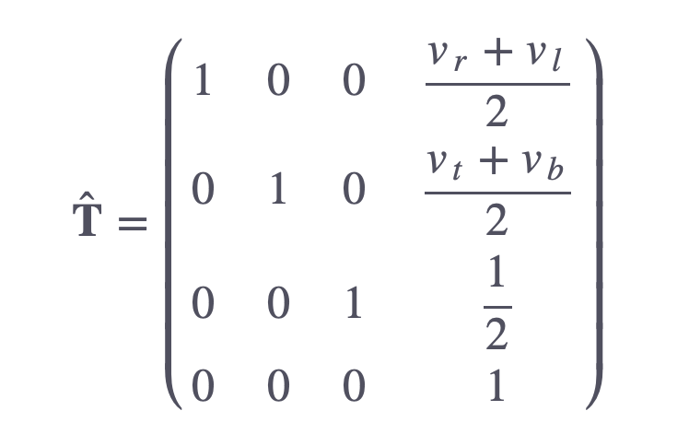
Viewport Transformation

Slide 8
Important Note
Remember to invert the mouse’s y-coordinate since the y-coordinates of the window go from bottom to top whereas the y-coordinates of the screen go from top to bottom.
For depth value (Z), you can manually go from -1 to 1 ( zNear, zFar ).
Set w = 1.0 (Homogeneous Coordinate)

Slide 9
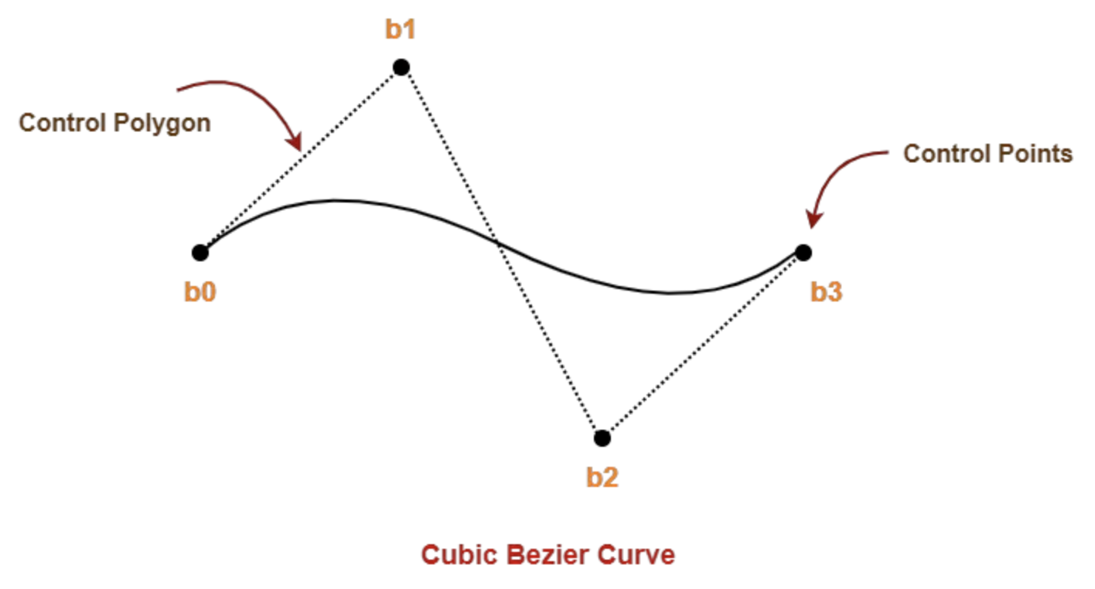
Bezier Curve
Bezier curve is defined by a set of control points b₀, b₁, b₂ and b₃.
Points b₀ and b₃ are the ends of the curve.
Points b₁ and b₂ determine the shape of the curve.

Slide 10
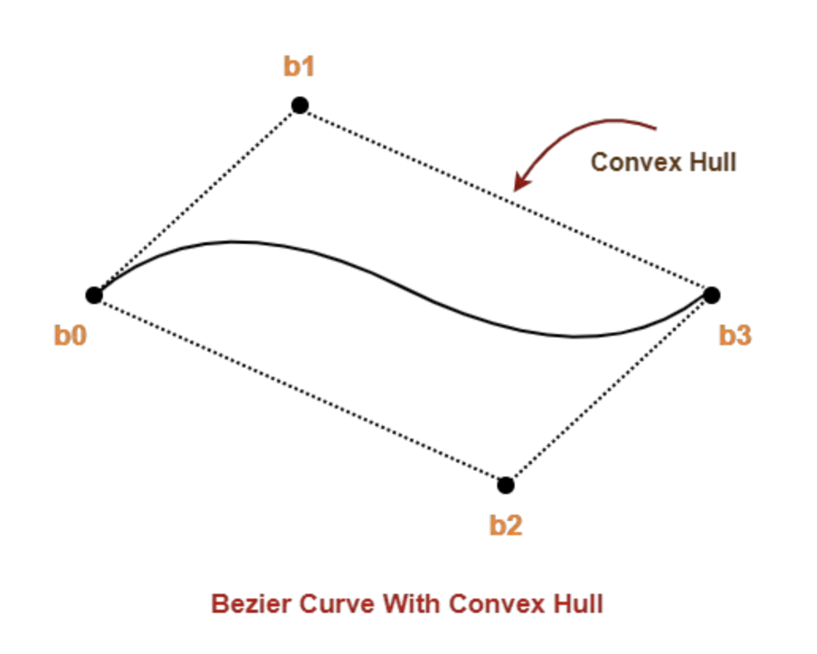
Bezier Curve
Bezier curve is always contained within a polygon called as convex hull of its control points.
The degree of the polynomial defining the curve segment is one less than the total number of control points.

Slide 11
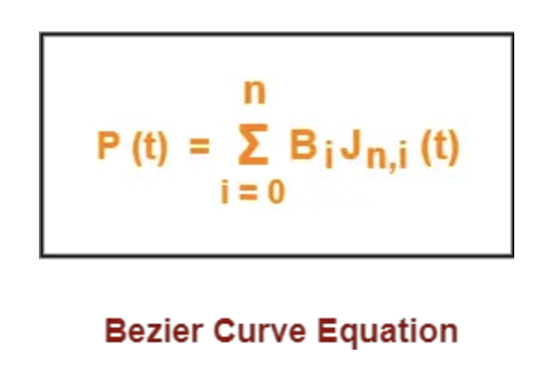
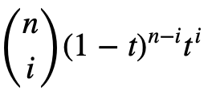


Bezier Curve
$$Jn,i$$
(t)
$$=$$
t is any parameter where 0 <= t <= 1
P(t) = Any point lying on the bezier curve
B_{i} = i^{th} control point of the bezier curve
n = degree of the curve
J_{n,i}(t) = Blending function = C(n,i)t^{i}(1-t)^{n-i} where C(n,i) = n! / i!(n-i)!

Slide 12













3D Object Drawing
Z = r cos (theta)
X = r sin (theta)
Y same for all the points on the circle

Slide 13
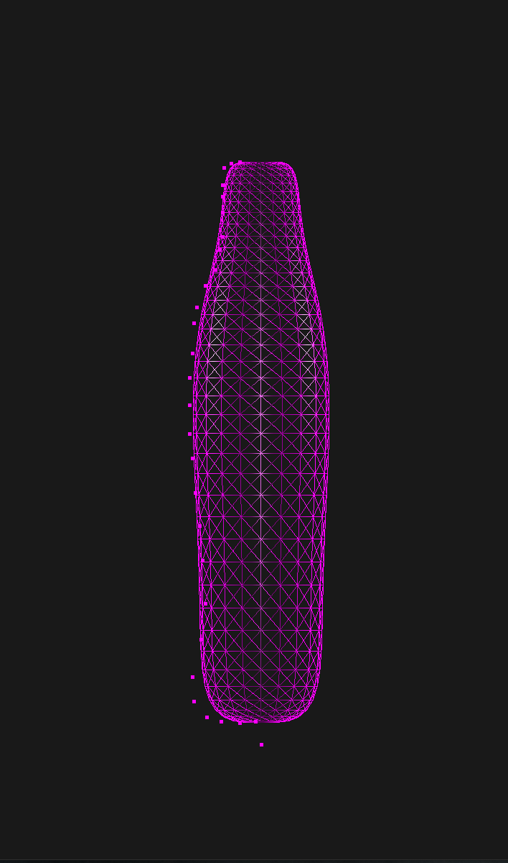
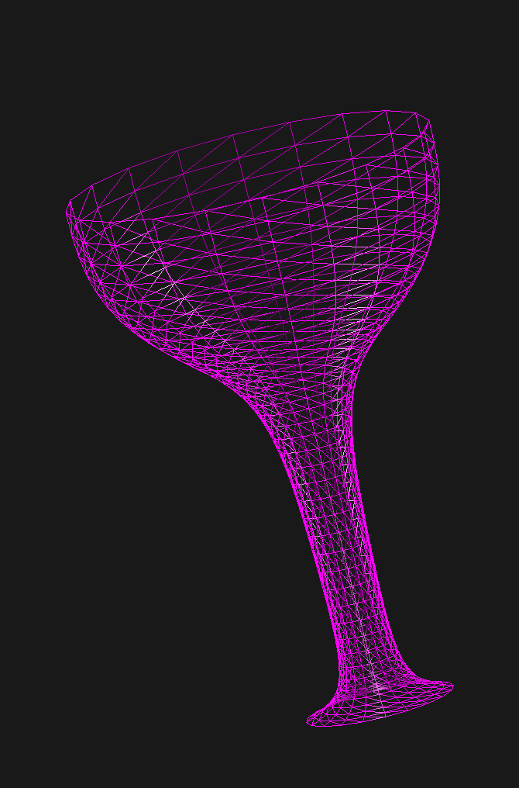
Some 3D Objects Drawn Using Curve

Slide 14
References
https://stackoverflow.com/questions/7692988/opengl-math-projecting-screen-space-to-world-space-coords
https://glasnost.itcarlow.ie/~powerk/GeneralGraphicsNotes/projection/viewport_transformation.html#:~:text=The%20Viewport%20Transformation&text=The%20u%20and%20v%20coordinates,depth%20value%20will%20be%20called%20.
https://www.gatevidyalay.com/bezier-curve-in-computer-graphics-examples/

